Slide 1
Introduction to Python
Dr. Kinga Sipos
Mathematical Institute, University of Bern

Slide 2
Links
This presentation: https://docs.google.com/presentation/d/199Q6Cxq_G7wiBEr4s1Zw3FSJDEqe77NkLys8FQMXf0g/edit?usp=sharing

Slide 3

The Python data analysis ecosystem
... A programming language and a way to execute it ...

Slide 4
Python: a programming language
price_per_m2 = [6, 10.3, 12.4, 10.6]
surface = [238, 239, 265, 212]
price = []
for i in range(len(price_per_m2)):
current_price = price_per_m2[i] * surface[i]
price.append(current_price)
Data structures
Control flow (for, if etc.)
Syntax, vocabulary etc.
Execute
[1428, 2461.7000000000003, 3286.0, 2247.2]

Slide 5
The Python data analysis ecosystem
... A programming language and a way to execute it ...

Slide 6




The Python data analysis ecosystem
... A programming language and a way to execute it ...
... Specific tools for our scientific task (packages) ...

Slide 7
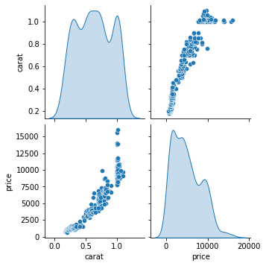
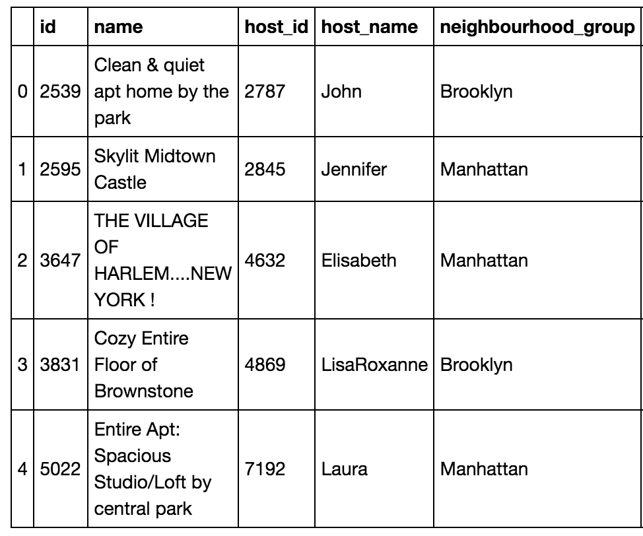
Data science libraries for Python
Axis #2: Columns
2 1 1 ... 0 0 0
1 2 2 ... 0 0 0
0 3 4 ... 1 2 1
...
3 4 6 ... 1 0 0
0 3 3 ... 1 0 1
0 2 2 ... 2 0 0
2 1 1 ... 0 0 0
1 2 2 ... 0 0 0
0 3 4 ... 1 2 1
...
3 4 6 ... 1 0 0
0 3 3 ... 1 0 1
0 2 2 ... 2 0 0
Axis #1: Rows
2 1 1 ... 0 0 0
1 2 2 ... 0 0 0
0 3 4 ... 1 2 1
...
3 4 6 ... 1 0 0
0 3 3 ... 1 0 1
0 2 2 ... 2 0 0
Axis #3: Stack
Numpy arrays: homogeneous multi-dimensional list for numerical calculation
Pandas dataframes: inhomogeneous 2-dimensional lists for data wrangling and analysis
Plotting and stats (Matplotlib and Seaborn): easily create complex plots and extract statistics from data

Slide 8
The Python data analysis ecosystem
... A programming language and a way to execute it ...
... Specific tools for our scientific task (packages) ...

Slide 9

The Python data analysis ecosystem
... A programming language and a way to execute it ...
... Specific tools for our scientific task (packages) ...
... A solution to interact with code and data ...

Slide 10
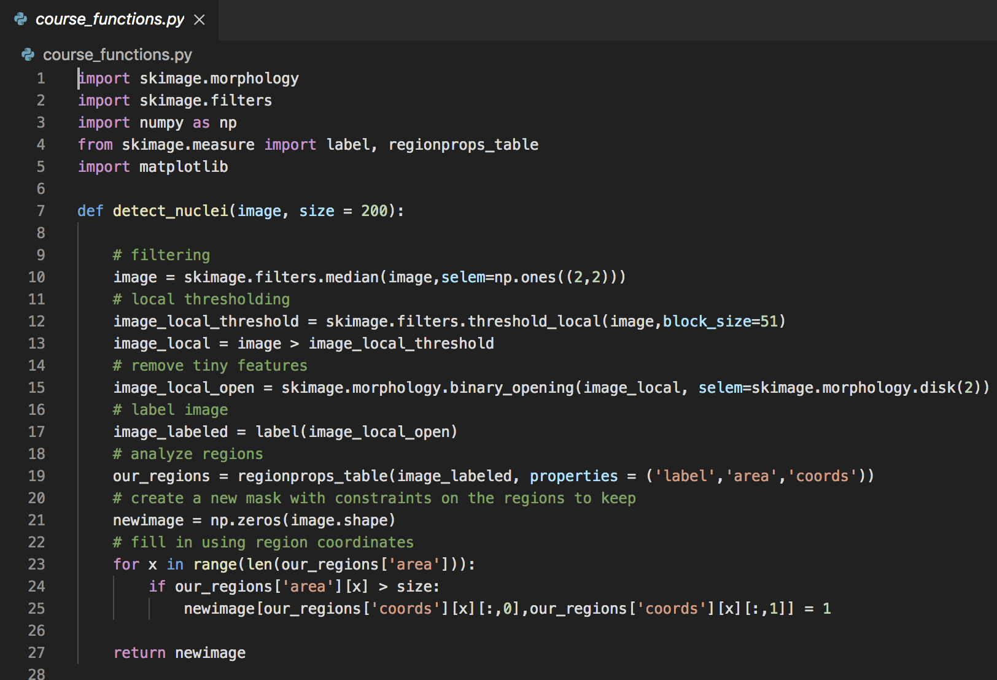
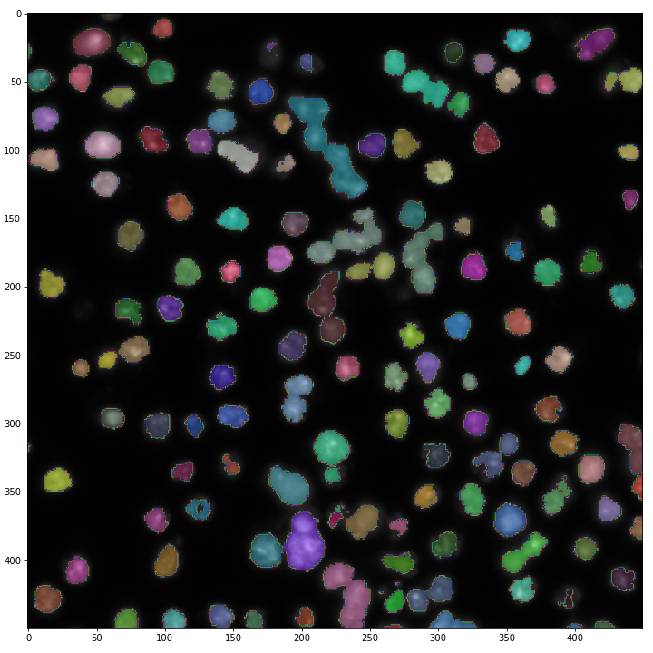
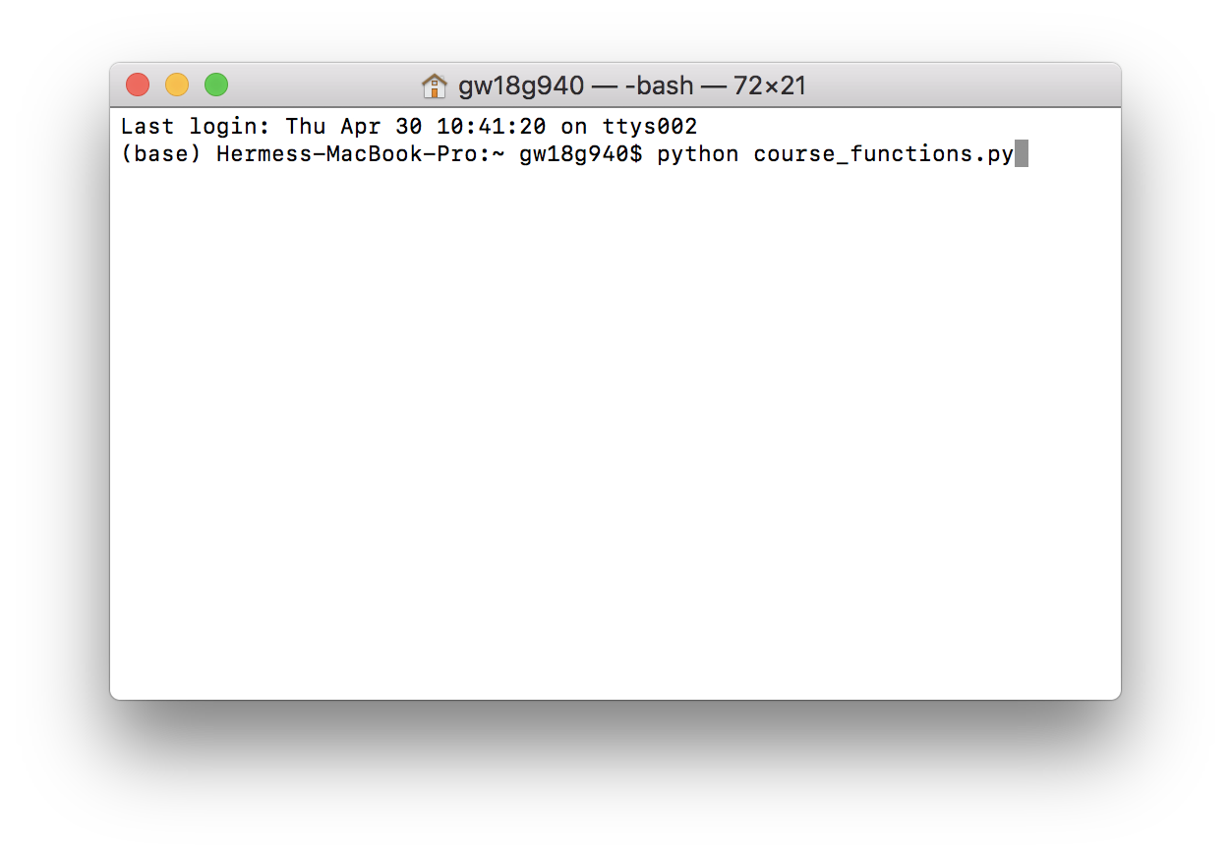
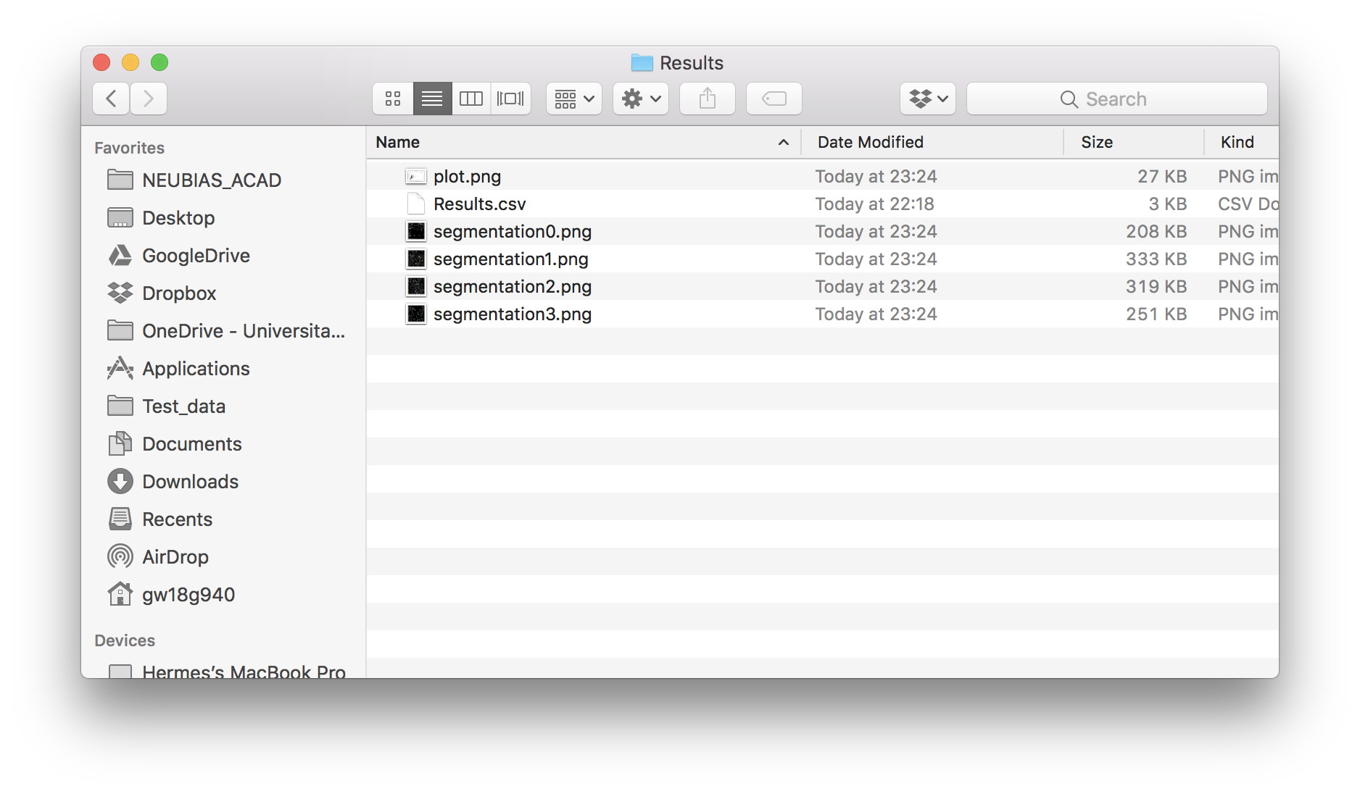
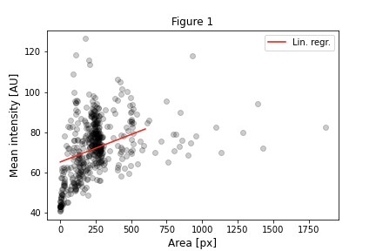
Executing software the “classical” way

Slide 11
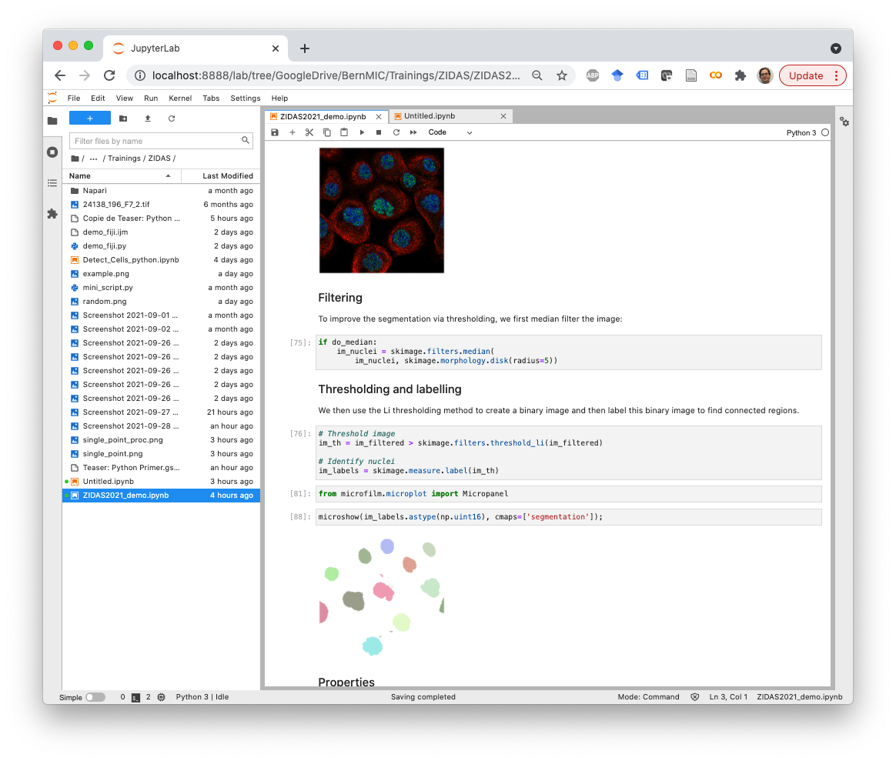
Interactive computing with
Write and execute code
Display images and plots
Document every step with formatted text (Markdown)
Execute code step by step

Slide 12
The Python data analysis ecosystem
... A programming language and a way to execute it ...
... Specific tools for our scientific task (packages) ...
... A solution to interact with code and data ...

Slide 13




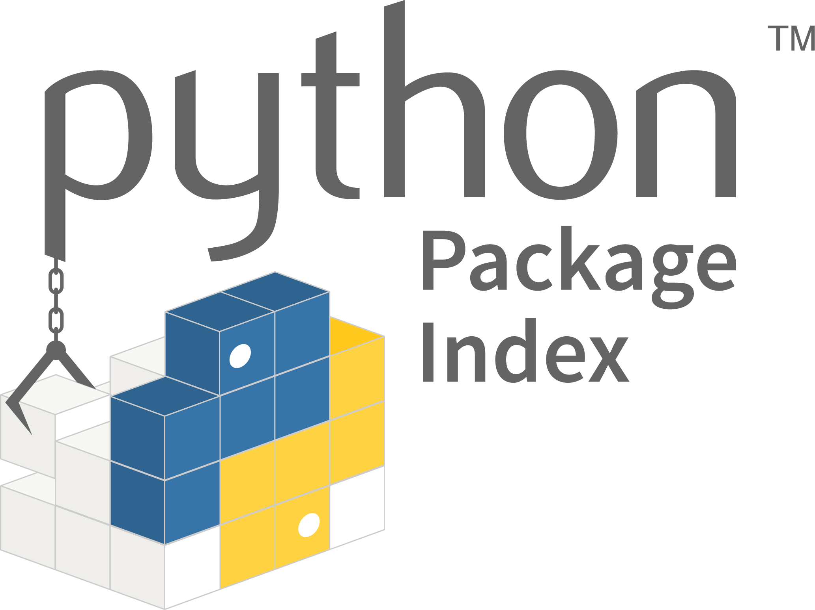

The Python data analysis ecosystem
... A programming language and a way to execute it ...
... Specific tools for our scientific task (packages) ...
... A solution to interact with code and data ...
... Infrastructure to install and run the code

Slide 14
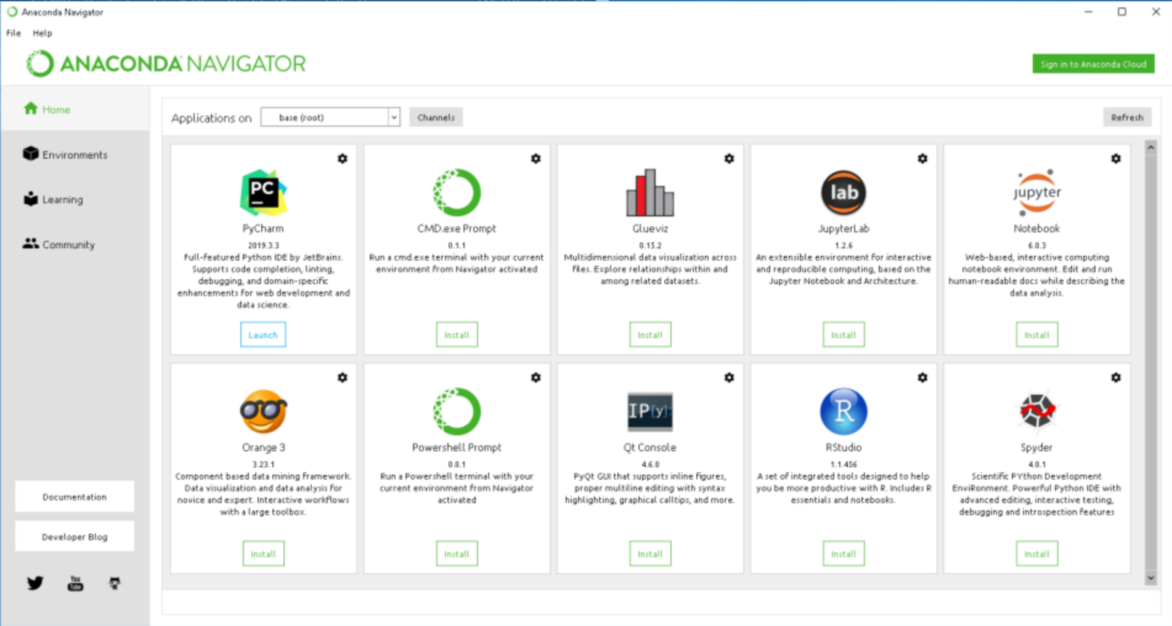
Running Jupyter locally
Local installation: we recommend using an installation based on the software conda
Miniconda: command line based but light https://docs.conda.io/en/latest/miniconda.html
Anaconda: Easy to use graphical interface but heavier (https://www.anaconda.com/products/individual)

Slide 15
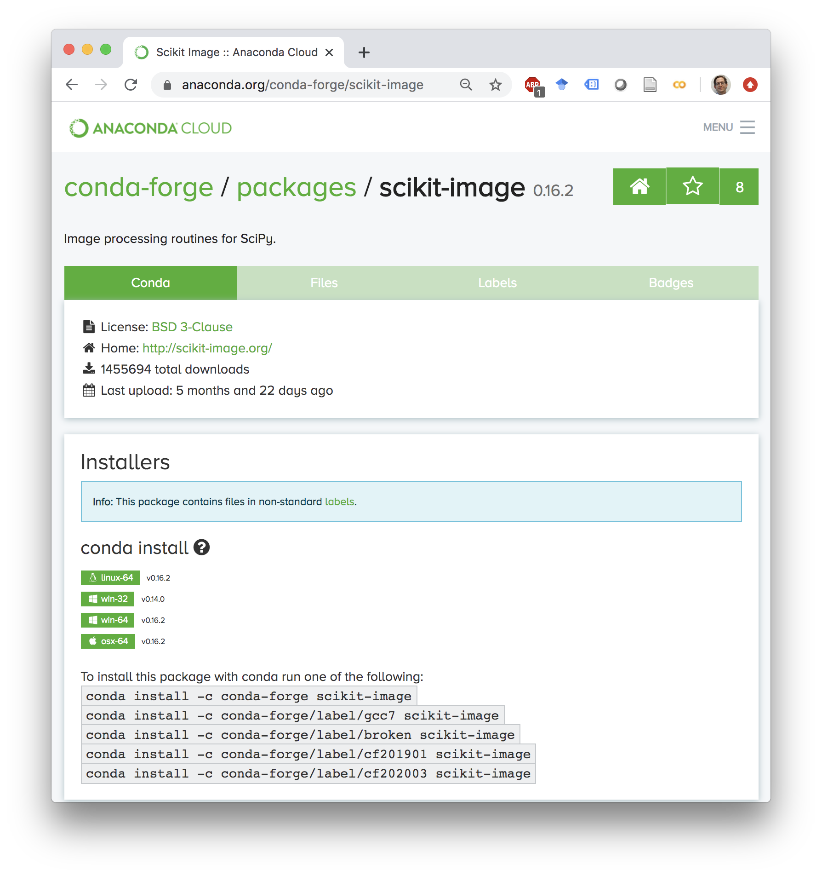
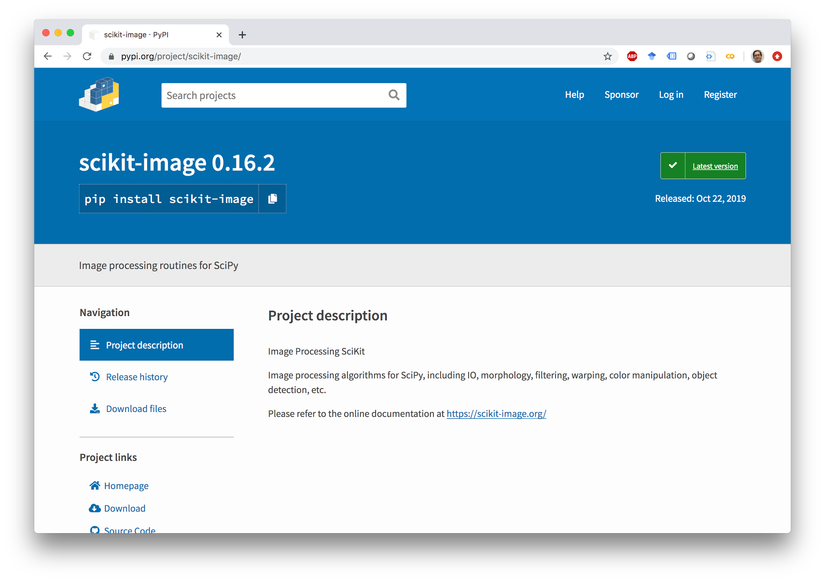
Installing the other packages
Packages can be installed via two “update sites”: conda and the python package index (pip) using simple commands. Alternatively, packages can be added directly through the interface of Anaconda.

Slide 16
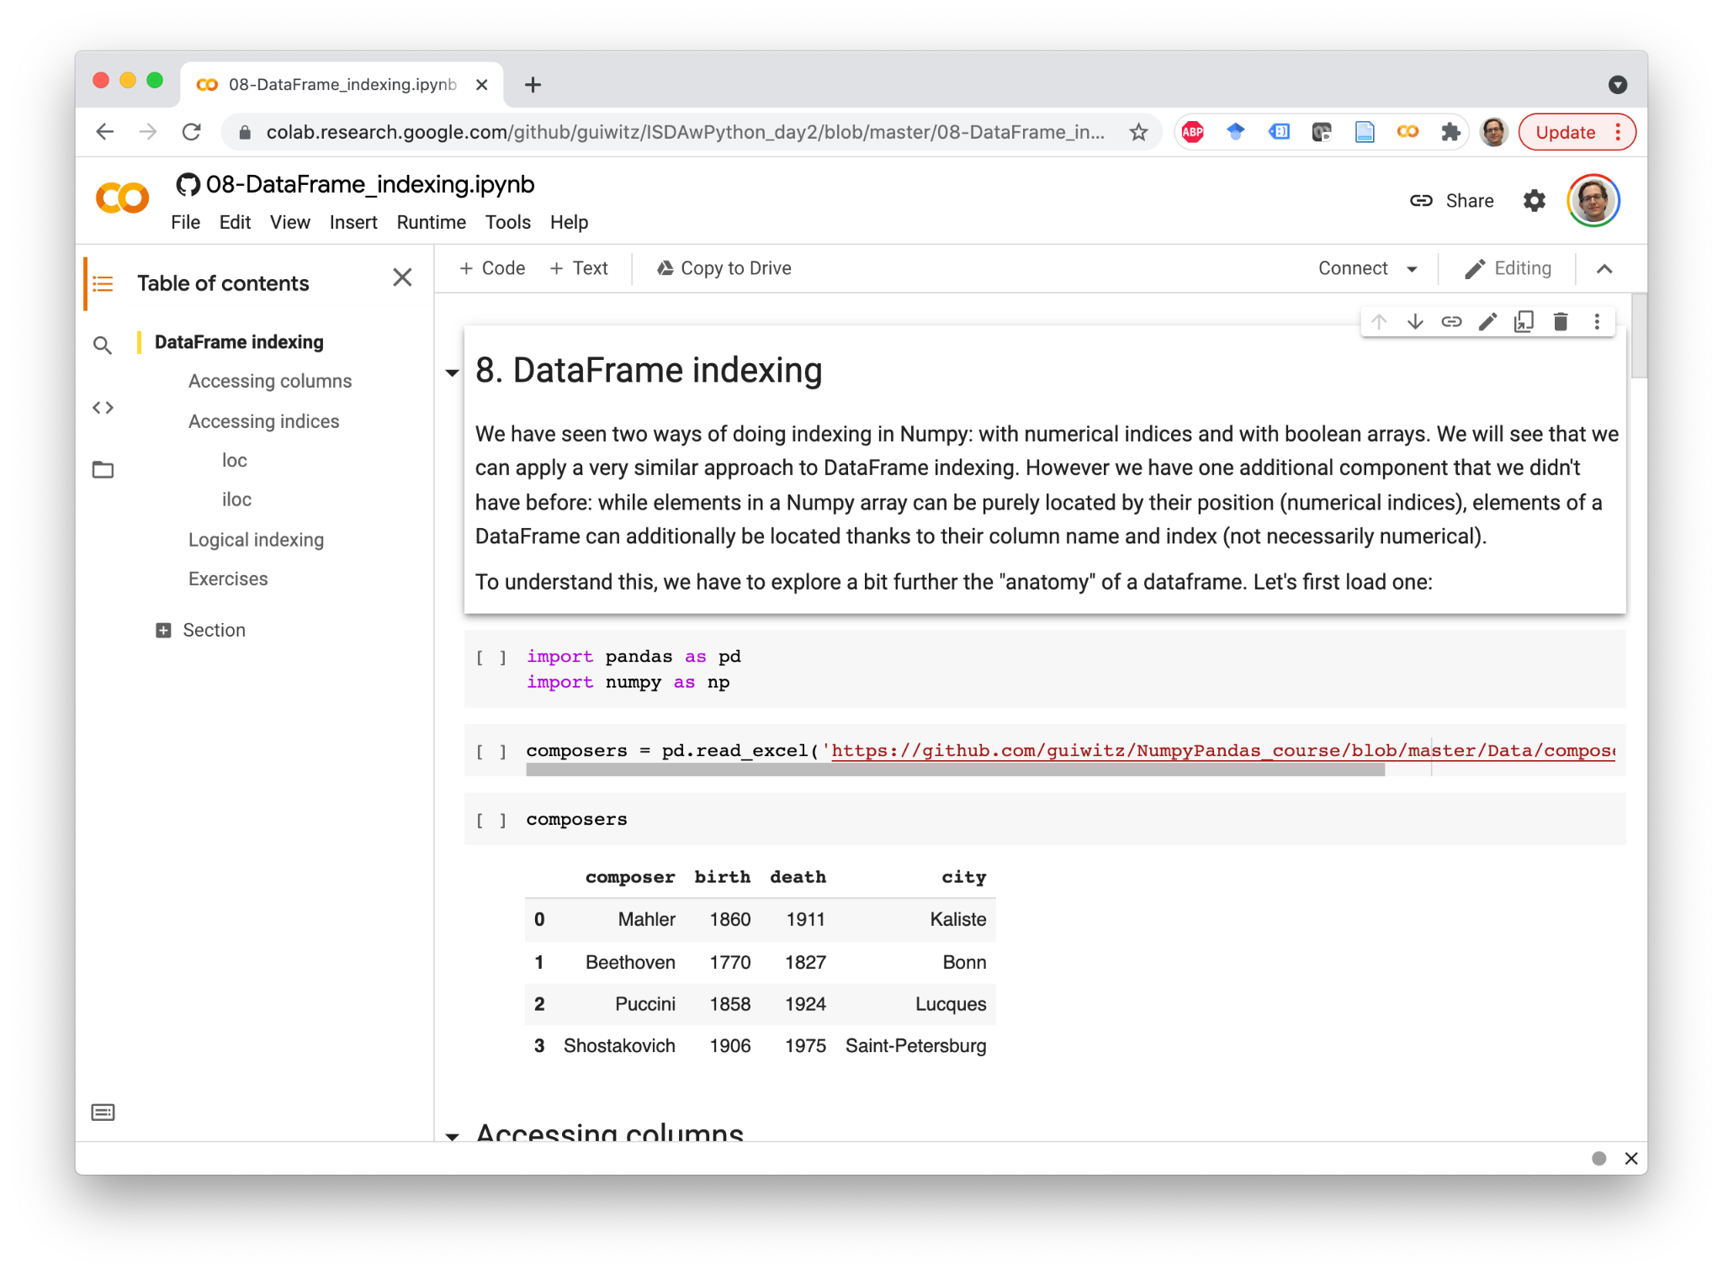
Google Colab notebooks
Google’s version of Jupyter
Same basic principles, different layout
Kernels run on Google infrastructure for free
Opens any notebook from Github
https://colab.research.google.com/

Slide 17
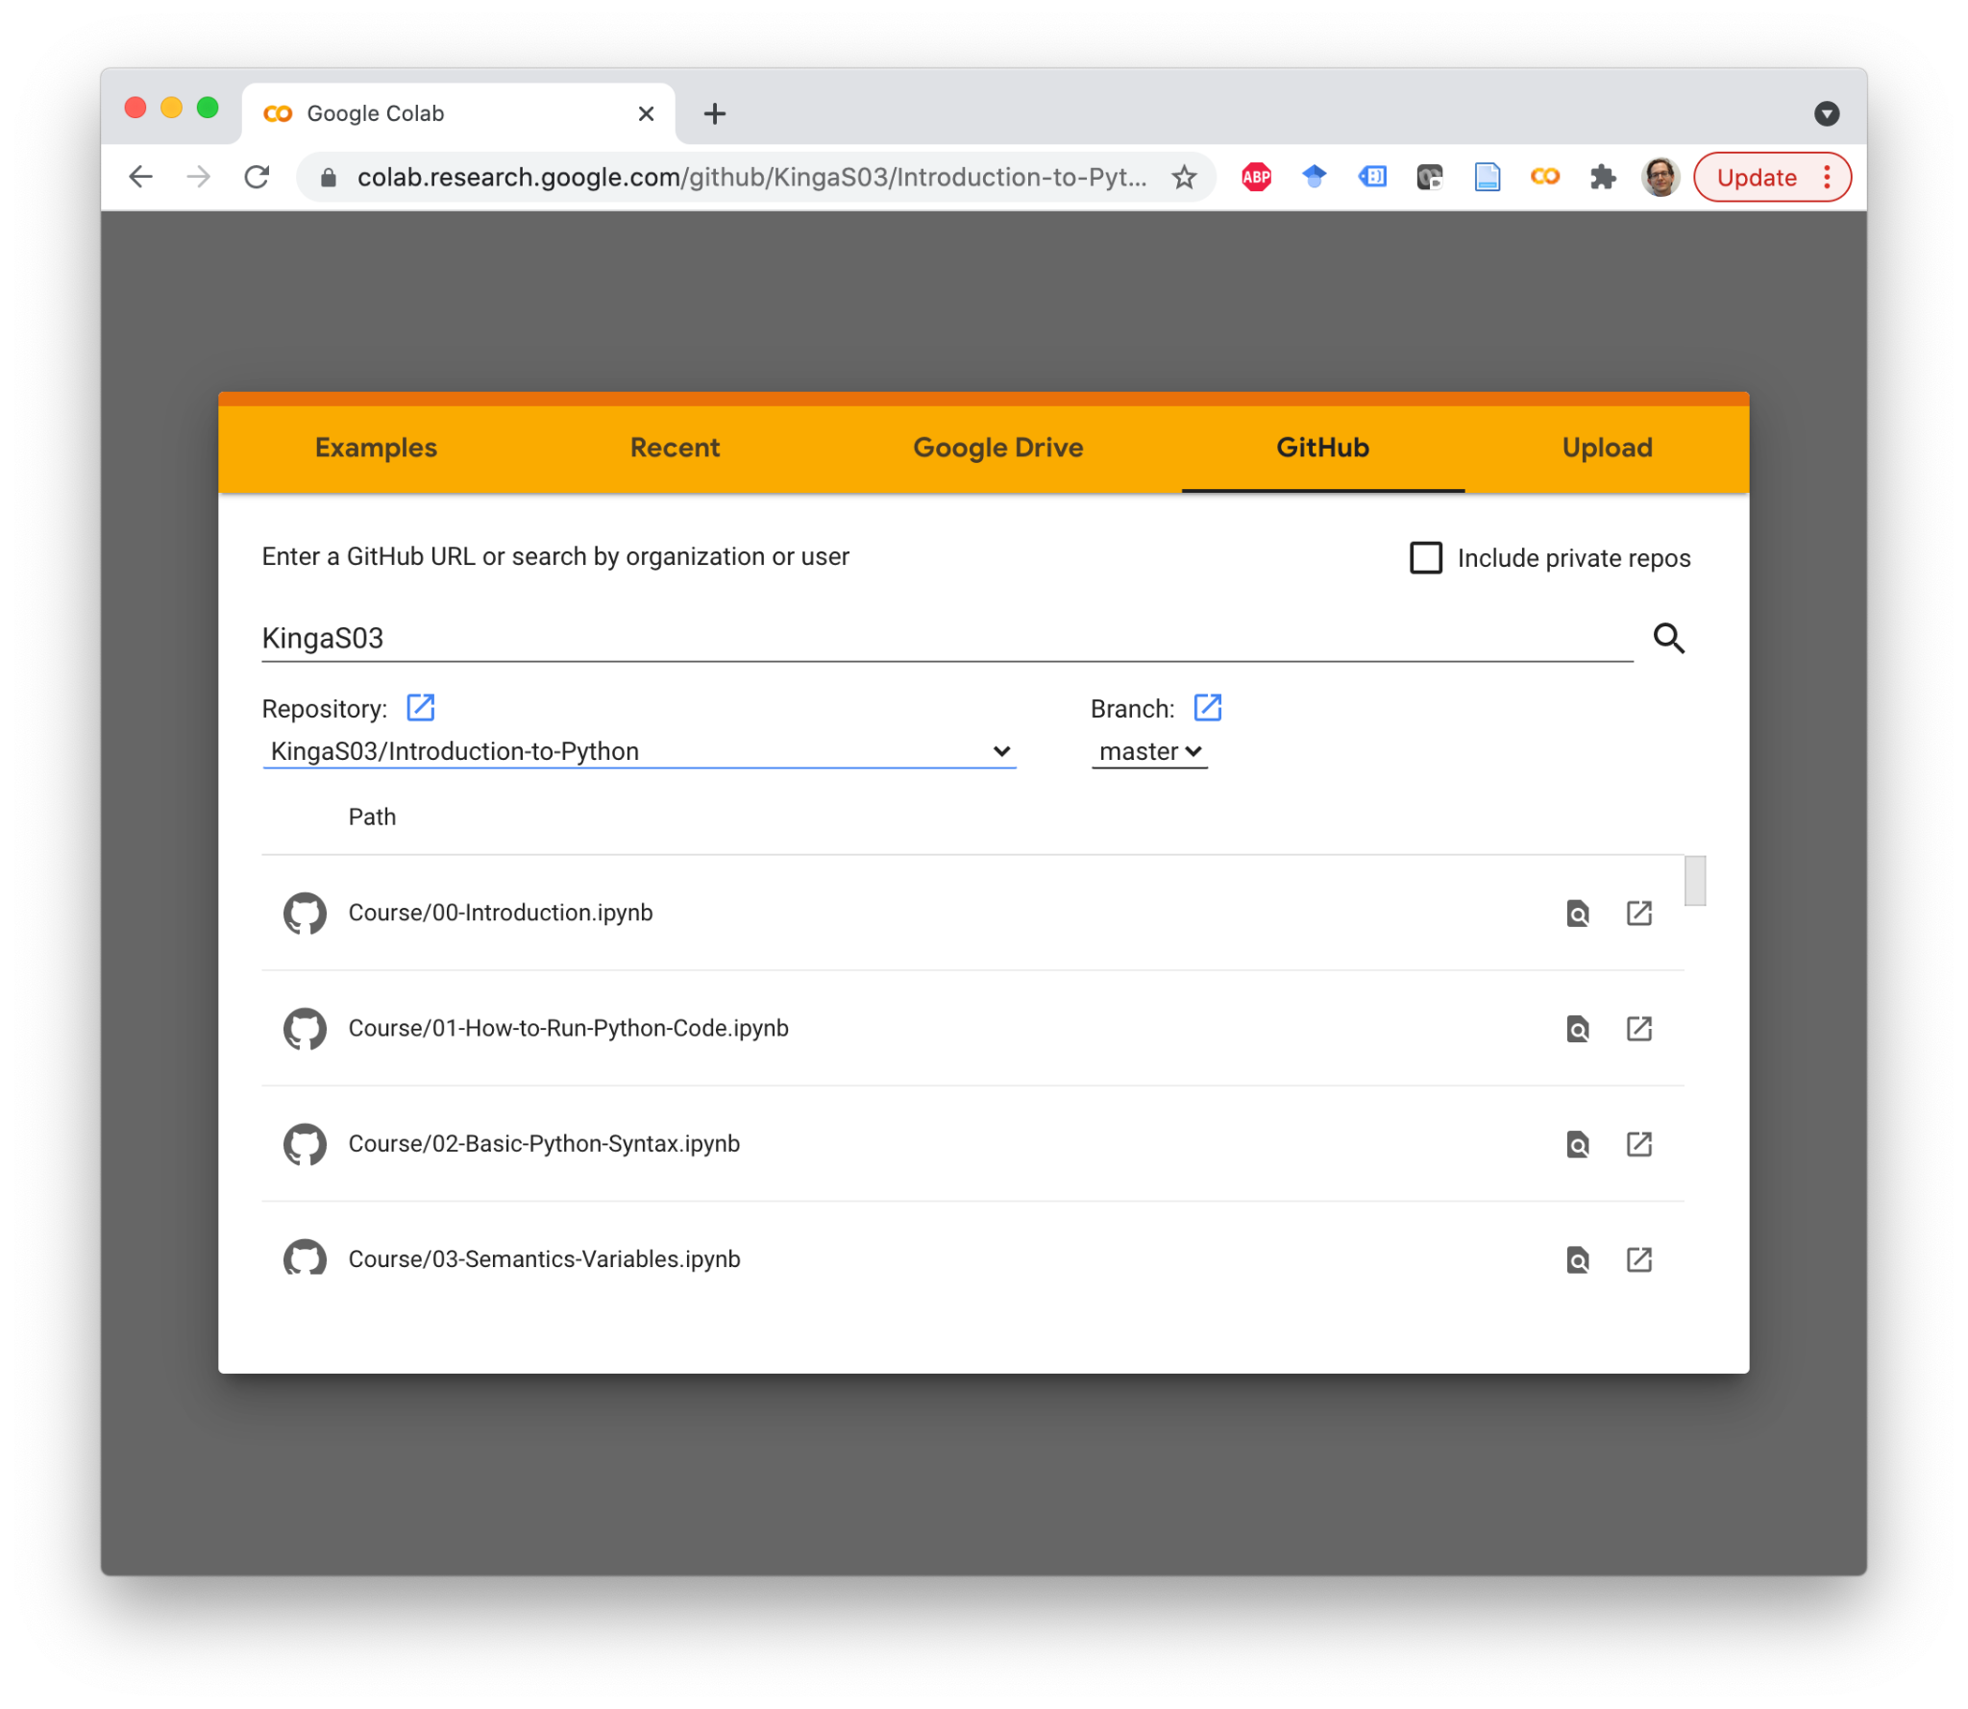
Teaching material on Colab
Choose a notebook from the list of all those available in that GitHub repository
If you make changes that you want to keep, save a copy of the notebook
The saved notebook ends up in a “Colab notebooks” folder on Google Drive
You can open/save notebooks from anywhere on Google Drive

Slide 18
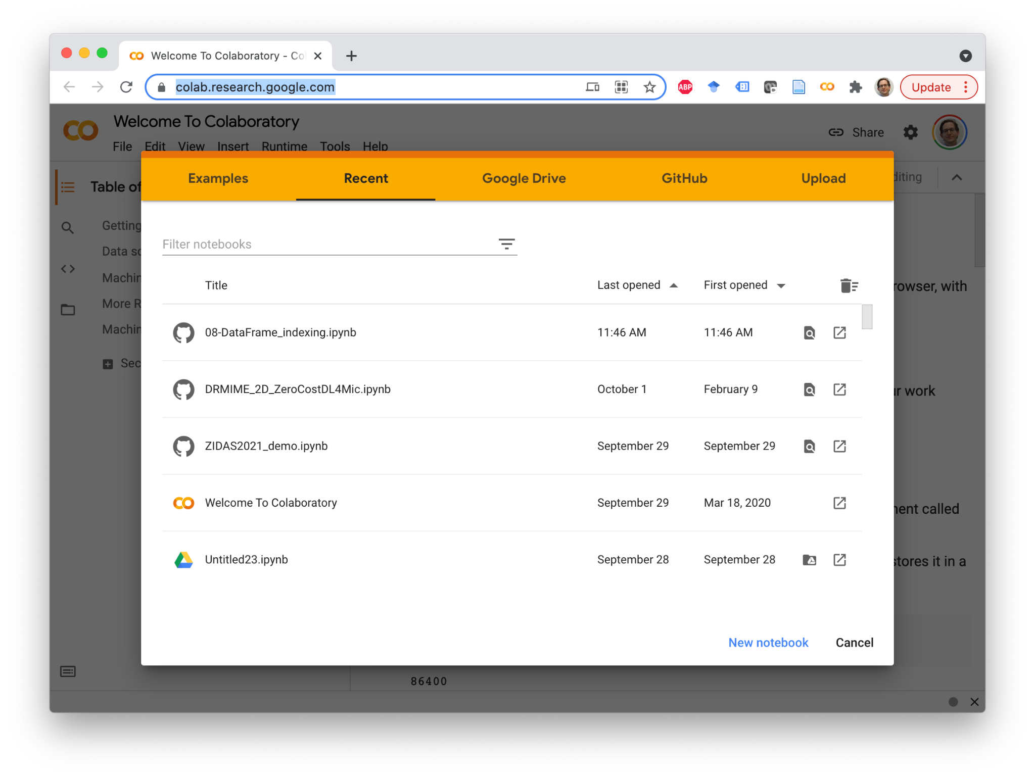
Let’s try
Login to your Google account
Follow this link to open an empty notebook: https://colab.research.google.com/
Select New Notebook (bottom right)

Slide 19
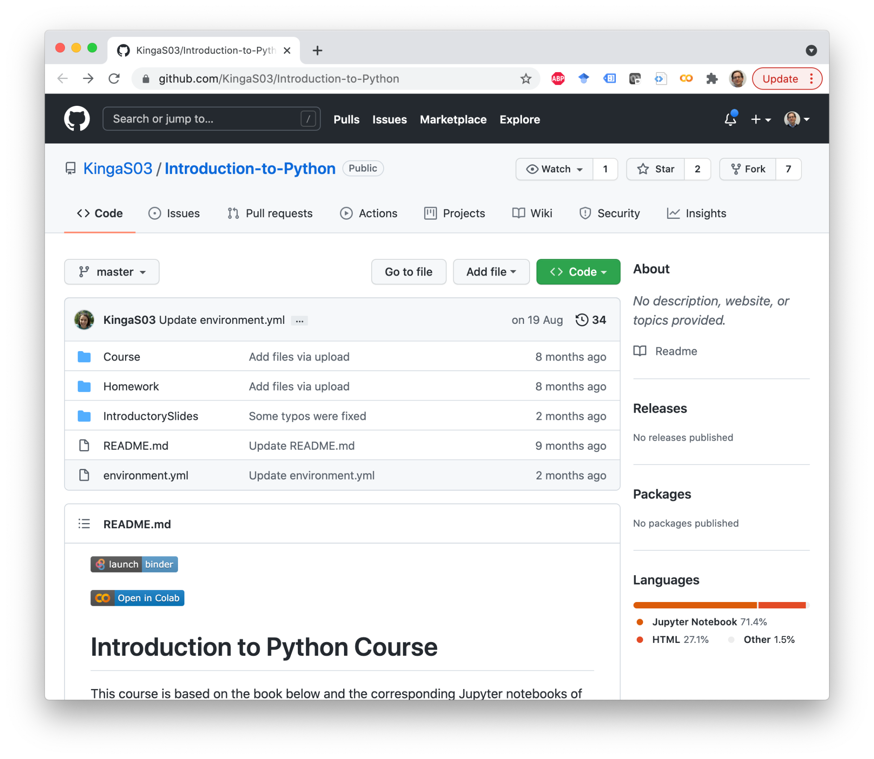
Teaching material on Colab
The entire teaching material is in the form of notebooks
Notebooks are available on GitHub e.g. today: https://github.com/KingaS03/Introduction-to-Python
Notebooks can be read on GitHub as static text
You can use notebooks interactively on Colab using the Colab badge

Slide 20
Public Jupyter resources
With switch-AAI login (same as Ilias login):
EPFL: https://noto.epfl.ch/
Jupyter running on EPFL servers, fully customizable environments
With switch-edu or GitHub:
Swiss Data Science Center: https://renkulab.io/
Powerful combination of Jupyter, GitHub and data repository
With Kaggle (ML competition site): https://www.kaggle.com/
Access to interesting datasets, GPU etc.

Slide 21
Notebook cheat sheet
Jupyter/Colab
Shift+Enter: Execute a cell
Esc: get out of a cell
a: add a cell above current cell
b: add a cell below current cell
Jupyter
dd: delete cell
m: turn cell to markdown
y: turn cell to code
Markdown
Title: #Title
Subtitle (etc): ##Subtitle
Bold: *bold*
Italic: **italic**
Web link: [my link](https://www.google.com/)
File link: [my file](mynotebook.ipynb)
LateX: $\delta = 3 * \sum a^2$

Slide 22
Link to the resources of the curse
https://github.com/KingaS03/Introduction-to-Python

